Slide 1

FOOD RECIPE SEARCH ENGINE
HARMANJIT SINGH & VINAY SACHDEVA
(1710991290) (1710991892)

Slide 2
PROBLEM STATEMENT
We all have those times when we don’t know what we could make for ourselves to eat from what we have available with us. Even if we do we , may not know about a new recipe that can be made from the same ingredients or an old recipe that can be made in a different way. Today there are innumerable applications that provide consumers with recipes ranging from quick to healthy and from beginner to expert, all intending to save time. But, none of these applications take into account whether he recipes ingredients are available with the consumer at the point of time or not. They fail to provide recipes containing only the ingredients that are available, thus proving to be inefficient and wasting time rather than saving it. These contemporary applications also do not evaluate and learn from the user’s choices thus further increasing the user’s task of repeating already fed information again. We plan on using a content-based recommendation system that will learn from user’s inputs and provide the user with refined recommended recipes which suit the user’s needs.

Slide 3
PROJECT CATEGORY
THE PROJECT COMES WEB DEVELOPMENT STRATEGIES(PROVIDE RECIPES TO THE CONSUMERS BASED ON THE INGREDIENTS AVAILABLE TO THEM)

Slide 4
Solution proposed
“Food Recipe Engine Application” is our initiative to provide recipes to the consumers based on the ingredients already available with them, unlike other recipe providing applications where the ingredients available with the consumer is not taken into consideration. Here the basic approach is to provide a platform for complete information , help , instructions and provide the facilities according to the user needs required by the user.
The application has three major functionalities in this application. They are browsing recipes based on search term or alphabetically. Search a cocktail based on search term or alphabetically and searching a beer based on search term or alphabetically. This also shows a random meal, cocktail and beer on there respective pages. My project aims to combine the features like search based on ingredients, suggestions for similar recipes, and images for the ingredients under one search engine and provide an intuitive interface for the same. The goal of this project is to suggest recipes to the user. For this, a database of recipes needs to be maintained. A web search engine can be used to retrieve the required information from the web. The study of a search engine would be helpful in understanding how it works and how the data can be retrieved and maintained in the database.

Slide 5
Advantages & features of food recipe search engine application
The User Friendly Application.
Complete information like recipe types, instructions and query regarding page is available.
You can search any particular recipes and specific recipe’s type instructions for the meals, etc.
To guide the user to the recipe based on the user’s choices and needs.
To help save the user money and time by tediously referencing cook books and buying ingredients he/she does not need.
Developed planning skills that plans a menu and grocery list which helps in explaining smart food choices with different mindsets.
A better understanding of the recipes going on currently and the target of the project to learn practical experience and understanding knowledge

Slide 6
Technologies used
HTML
CSS
JAVASCRIPT
BOOTSTRAP
AJAX
JQUERY
API(Application Programming Interface) Integration

Slide 7
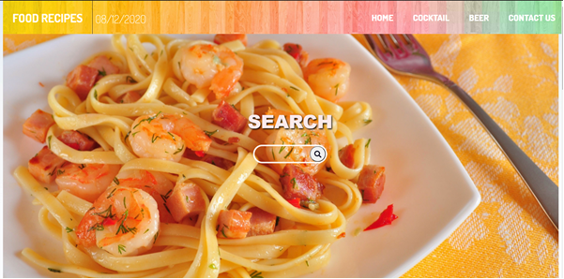
Project demonstration
.
Display a search bar which can be used to search for desired recipes based on search term entered by user.

Slide 8
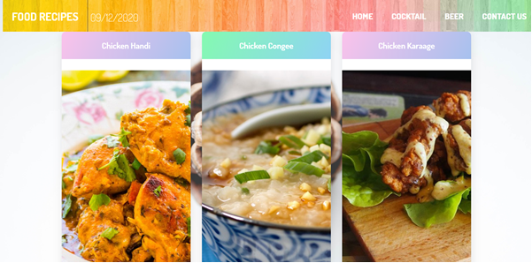
Search -
Search based on search term entered by user either an alphabet, recipe name or ingredient name.

Slide 9
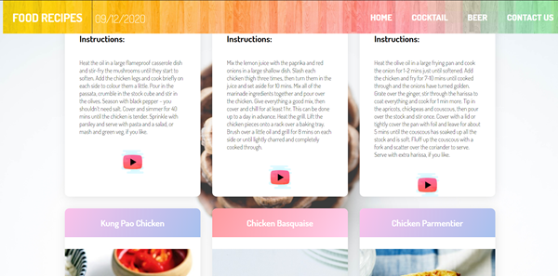
INSTRUCTIONS
The particular recipes instructions will be displayed along with their YouTube links.

Slide 10




Slide 11
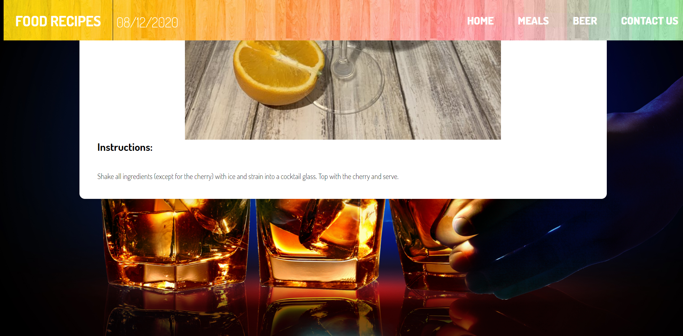
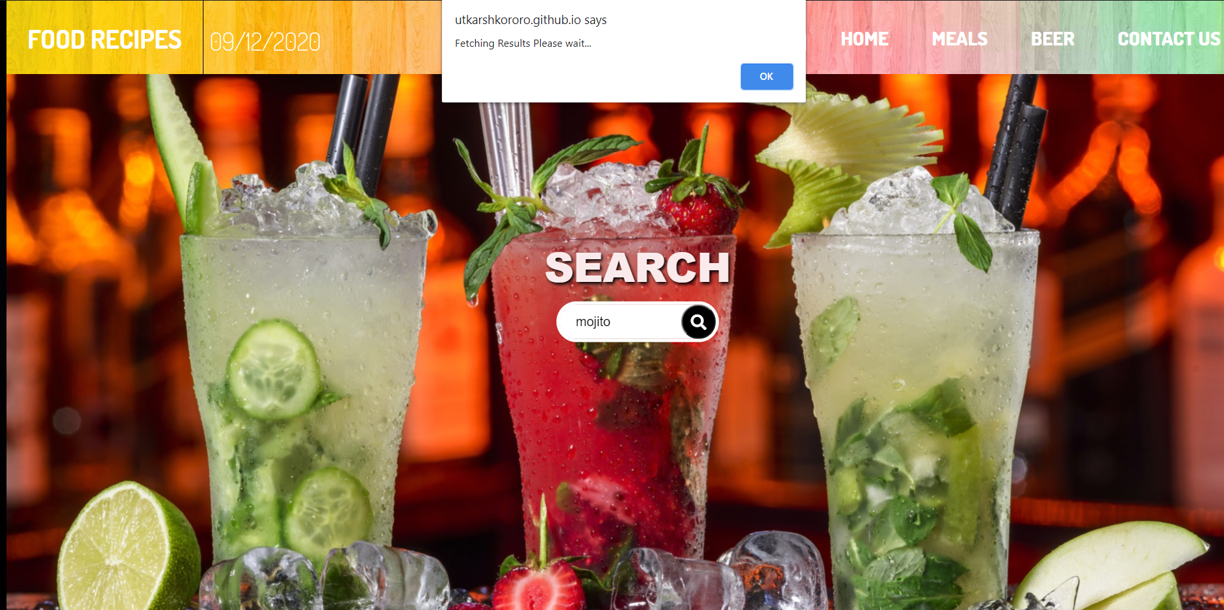

Slide 12
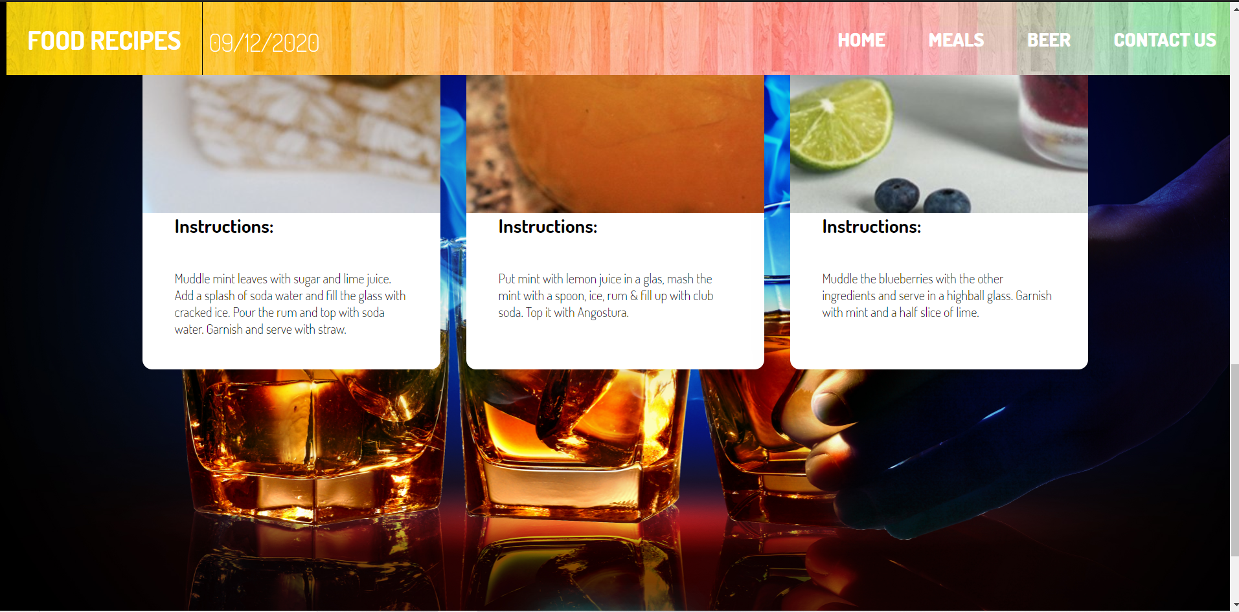

Slide 13

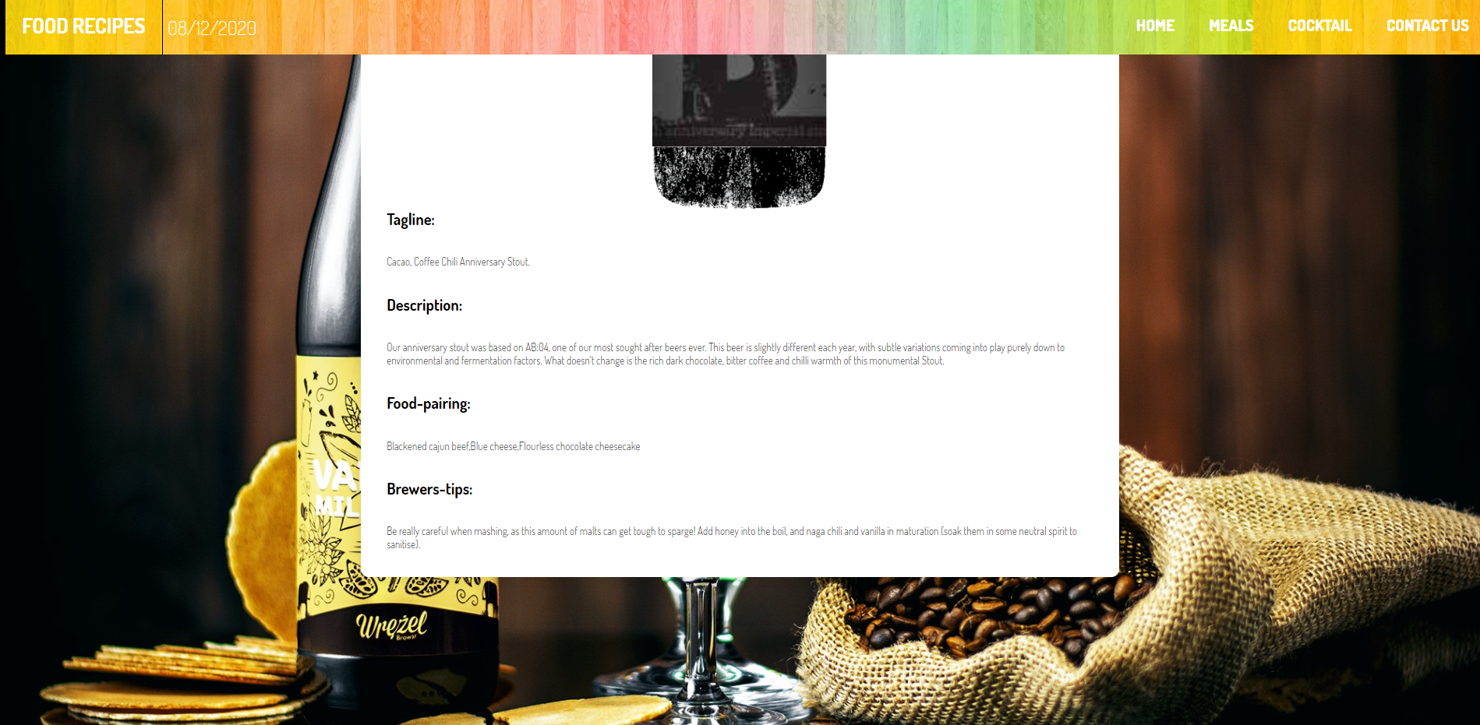

Slide 14
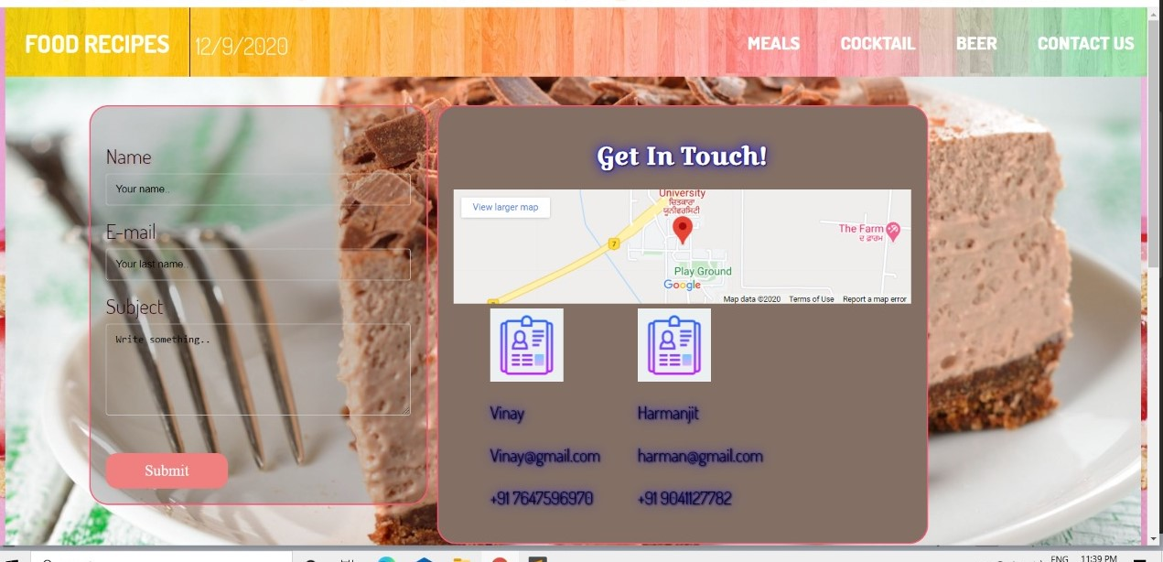

Slide 15


